Slide 1
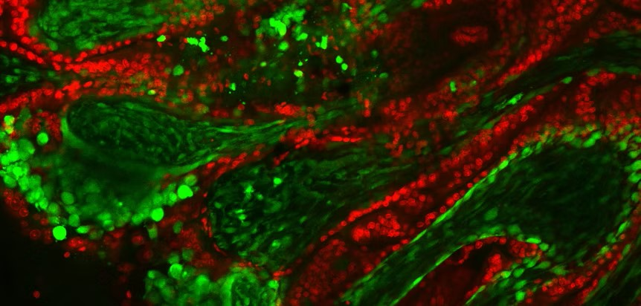

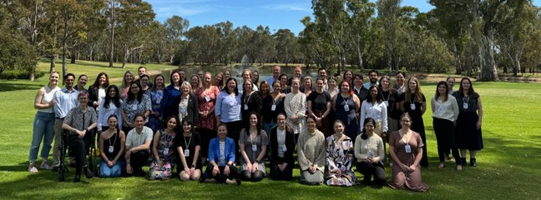

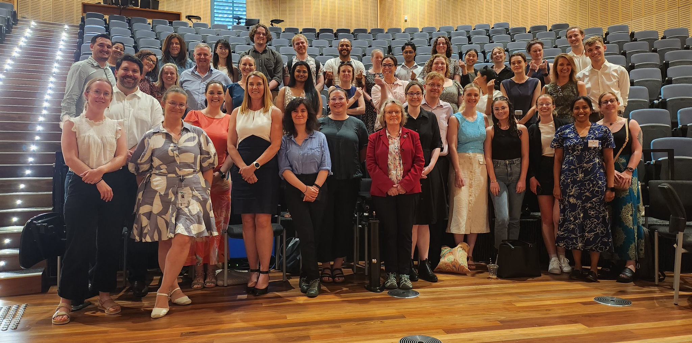
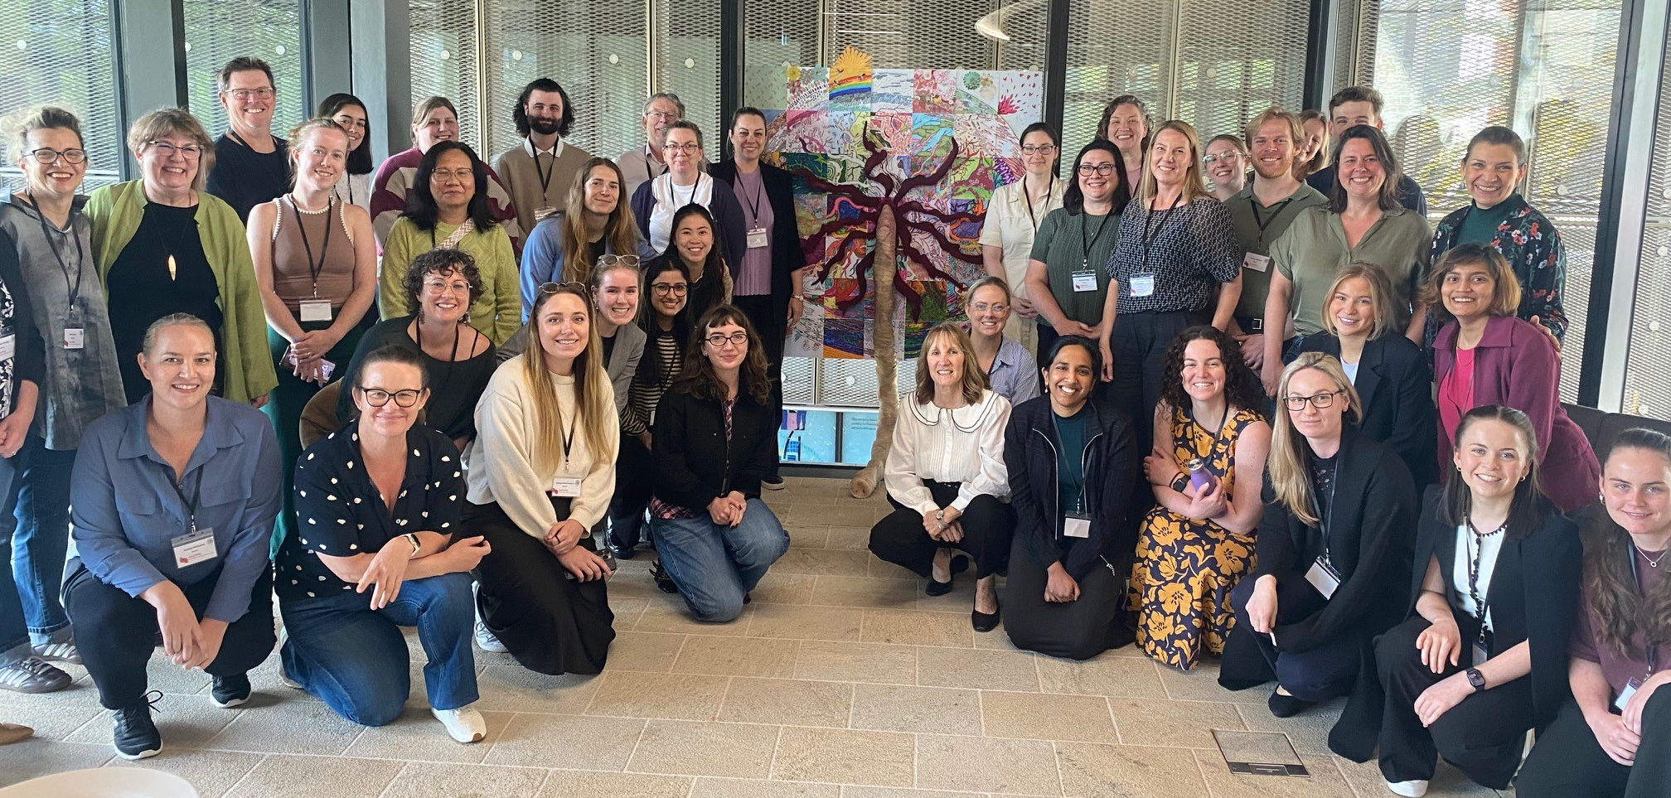
Love placentas? Love pregnancy? Join ANZPRA today!
www.anzpra.org
🤝 Connect with a diverse network of placental researchers
📚 Access training & knowledge-sharing opportunities
🏆 Apply for awards supporting Early Career Researchers
🌏 Collaborate across Australia, New Zealand & beyond
The more diverse our membership, the more we all learn from each other. We would love to have you as part of our family!

